Slide 1

Research Storage Simplified
John Reiland
Introduction to GPU Acceleration

Slide 2

View the Slides
https://github.com/ResearchComputing/Intro_GPU_Acceleration

Slide 3









Meet the User Support Team
Layla Freeborn
Brandon Reyes
Andy Monaghan
Michael Schneider
John
Reiland
Dylan Gottlieb
Mohal Khandelwal
Ragan
Lee
3

Slide 4
Session Overview
GPU Icon

Slide 5

Session Overview
Basics
Of GPUs
GPU Icon

Slide 6

Session Overview
Basics
Of GPUs
Code
Optimization
GPU Icon

Slide 7

Session Overview
Basics
Of GPUs
Code
Optimization
Monitoring
GPU Usage
GPU Icon

Slide 8
CPUs vs GPUs
8

Slide 9
CPUs vs GPUs
Processing Unit
Central
9

Slide 10
CPUs vs GPUs
Processing Unit
Central
Graphics
10

Slide 11


CPUs vs GPUs
Dozens
Of Cores
(1 Core)
(1 Process)
11
Notes:
add icon for parallel calculations

Slide 12

CPUs vs GPUs
Thousands
Of Cores
(1 Calculation)
(1 Core)
Dozens
Of Cores
(1 Core)
(1 Process)
12
Notes:
add icon for parallel calculations

Slide 13
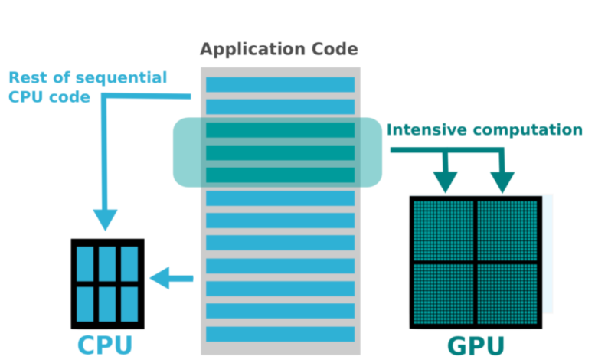
Computational Offloading
Graphic Source
13
Notes:
Expand on slide here to discuss how cpu & gpu work together
Source:
https://svi.nl/HuygensGPU

Slide 14
GPU Acceleration Checklist
14

Slide 15
GPU Acceleration Checklist
Computational Intensity
15

Slide 16
GPU Acceleration Checklist
Computational Intensity
Algorithmic Complexity
16

Slide 17
GPU Acceleration Checklist
Computational Intensity
Algorithmic Complexity
Data Type
17

Slide 18
GPU Acceleration Checklist
Computational Intensity
Algorithmic Complexity
Data Type
Data Dependency
18

Slide 19
Computational Intensity
VS
Calculations
Data Access
19
Notes:
Slide 12 (Data Dependency) - Add an example of a sequential instruction, Add in info on shared memory – why this is also an issue for gpu / cpu operations
num_apples = 4
apple_weight = num_apples * 0.25
apple_cost = apple_weight * 1.50 < Must wait for apple_weight to be calculated
Or
Calculations …
Total = array[prev] + array[current] < Must wait until the previous calculation has finished!
Calculations…

Slide 20
Algorithmic Complexity
VS
Calculations
Branching Logic
20
Notes:
Slide 12 (Data Dependency) - Add an example of a sequential instruction, Add in info on shared memory – why this is also an issue for gpu / cpu operations
num_apples = 4
apple_weight = num_apples * 0.25
apple_cost = apple_weight * 1.50 < Must wait for apple_weight to be calculated
Or
Calculations …
Total = array[prev] + array[current] < Must wait until the previous calculation has finished!
Calculations…

Slide 21
Data Type
123
“Text”
VS
Numeric
Complex Objects
21

Slide 22


Data Dependency
Recursion
Temporal
Time / Dates
22
Notes:
Slide 14 - Rephrase from “simple” to “Limited branching” - the more “decisions” a program has to make, the slower it will be. Best to focus on computation or handle branching before computation.
- Example, instead of having the code evaluate each line of a dataset, perhaps we split the dataset into separate files. Now the code only processes what it needs to - no branching.

Slide 23
GPU Acceleration Checklist
Computational Intensity
Algorithmic Complexity
Data Type
Data Dependency
23

Slide 24
Alpine GPUs
 | NVIDIA |  |  | AMD
Type | A100 | L40 | GH200 | MI100
Cores | 7k | 15K | 17k | 7.7k
VRAM | 40 / 80 | 48 | 96 | 32
Purpose | General | Viz, AI Inference | AI Training, High Data I/O | Scientific
24
Notes:
Slide 6 - Update hardware information to match current numbers and include L20’s and Grace Hopper
List out all of the GPU partitions and what each is good for (pros / cons)
*Overall note – nvidia gpu’s focus on AI/ML workflows, while AMD provides stronger performance with general computing tasks (e.g. scientific operations that use large floating point values) – great option for scientific/precise computing.

Slide 25
Alpine GPUs
 | NVIDIA |  |  | AMD
Type | A100 | L40 | GH200 | MI100
Partition | aa100 | al40 | gh200* | ami100
Nodes | 40 (8) / 80 (4) | 3 | 2 | 2
GPUs Per Node | 3 | 3 | 1 | 3
25

Slide 26
Requesting GPUs
SLURM Directives:
--partition= < >
--gres=gpu:<#>
--ntasks=<#>
26
Notes:
Slides 19 and 20 – convert to smaller blurbs focusing on the main restrictions – time, # of GPU’s, etc.
Include updated information on MIG

Slide 27
Requesting GPUs
SLURM Directives:
--partition= < >
--gres=gpu:<#>
--ntasks=<#>
sinteractive --partition=ami100 --gres=gpu:2 --ntasks=20
#SBATCH <directive>
27
Notes:
Slides 19 and 20 – convert to smaller blurbs focusing on the main restrictions – time, # of GPU’s, etc.
Include updated information on MIG

Slide 28



Code Optimization
Libraries
Directives
Languages
GPU Icon

Slide 29
Key Terms
Host == CPU
Device == GPU
Kernel == Functions launched on GPU
29
Notes:
Host – CPU,
Device – GPU
Kernel – functions launched on the GPU

Slide 30
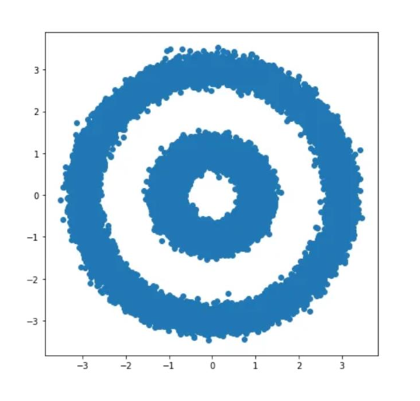
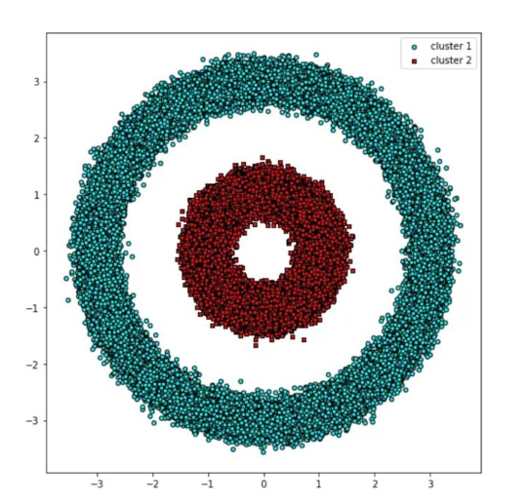
GPU Libraries – Drop in Replacement
#create dataset with 100,000 points
from sklearn.datasets import make_circles
X, y = make_circles(n_samples=int(1e5), factor=.35, noice=.05)
#run DBSCAN clustering algorithm
from sklearn.cluster import DBSCAN
db = DBSCAN(eps=0.6, min_samples=2)
y_db = db.fit_predict(X)
Dataset
Clusters
30

Slide 31
GPU Libraries – Drop in Replacement
#create dataset with 100,000 points
from sklearn.datasets import make_circles
X, y = make_circles(n_samples=int(1e5), factor=.35, noice=.05)
#run DBSCAN clustering algorithm
from sklearn.cluster import DBSCAN
db = DBSCAN(eps=0.6, min_samples=2)
y_db = db.fit_predict(X)
31

Slide 32
GPU Libraries – Drop in Replacement
#create dataset with 100,000 points
from sklearn.datasets import make_circles
X, y = make_circles(n_samples=int(1e5), factor=.35, noice=.05)
#convert dataset to Pandas DataFrame
#run DBSCAN clustering algorithm
from sklearn.cluster import DBSCAN
db = DBSCAN(eps=0.6, min_samples=2)
y_db = db.fit_predict(X)
32

Slide 33
GPU Libraries – Drop in Replacement
#create dataset with 100,000 points
from sklearn.datasets import make_circles
X, y = make_circles(n_samples=int(1e5), factor=.35, noice=.05)
#convert dataset to Pandas DataFrame
import pandas as pd
import cudf
X_df = pd.DataFrame({‘fea%d’%i: X[:,i] for i in range(X.shape[1])})
X_gpu = cudf.DataFrame.from_pandas(X_df)
#run DBSCAN clustering algorithm
from sklearn.cluster import DBSCAN
db = DBSCAN(eps=0.6, min_samples=2)
y_db = db.fit_predict(X)
33

Slide 34
GPU Libraries – Drop in Replacement
#create dataset with 100,000 points
from sklearn.datasets import make_circles
X, y = make_circles(n_samples=int(1e5), factor=.35, noice=.05)
#convert dataset to Pandas DataFrame
import pandas as pd
import cudf
X_df = pd.DataFrame({‘fea%d’%i: X[:,i] for i in range(X.shape[1])})
X_gpu = cudf.DataFrame.from_pandas(X_df)
#run DBSCAN clustering algorithm
from sklearn.cluster import DBSCAN
db = DBSCAN(eps=0.6, min_samples=2)
y_db = db.fit_predict(X)
#run GPU-accelerated DBSCAN
from cuml import DBSCAN
34

Slide 35
GPU Libraries – Drop in Replacement
#create dataset with 100,000 points
from sklearn.datasets import make_circles
X, y = make_circles(n_samples=int(1e5), factor=.35, noice=.05)
#convert dataset to Pandas DataFrame
import pandas as pd
import cudf
X_df = pd.DataFrame({‘fea%d’%i: X[:,i] for i in range(X.shape[1])})
X_gpu = cudf.DataFrame.from_pandas(X_df)
#run DBSCAN clustering algorithm
from sklearn.cluster import DBSCAN
db = DBSCAN(eps=0.6, min_samples=2)
y_db = db.fit_predict(X)
#run GPU-accelerated DBSCAN
from cuml import DBSCAN
35

Slide 36
GPU Libraries – Drop in Replacement
#create dataset with 100,000 points
from sklearn.datasets import make_circles
X, y = make_circles(n_samples=int(1e5), factor=.35, noice=.05)
#convert dataset to Pandas DataFrame
import pandas as pd
import cudf
X_df = pd.DataFrame({‘fea%d’%i: X[:,i] for i in range(X.shape[1])})
X_gpu = cudf.DataFrame.from_pandas(X_df)
#run GPU-accelerated DBSCAN
from cuml import DBSCAN
db = DBSCAN(eps=0.6, min_samples=2)
y_db = db.fit_predict(X)
1
2
36

Slide 37

GPU-Enabled Frameworks
37
Notes:
Transition – if you don’t have a drop-in library or framework for your project, you can still optimize your code to utilize GPUs – you’ll need to consider Compiler Directives.

Slide 38

GPU Compiler Directives
38

Slide 39
GPU Compiler Directives
Kernel directives
Generate parallel accelerator kernels for the loop following the directive.
39

Slide 40
GPU Compiler Directives
Kernel directives
Generate parallel accelerator kernels for the loop following the directive.
//Hello_World_OpenACC.c
void Print_Hello_World()
{
#pragma acc kernels
for(int i=0; i<5; i++)
{
printf(“Hello World!\n”)
}
}
40

Slide 41
GPU Compiler Directives
Kernel directives
Generate parallel accelerator kernels for the loop following the directive.
Data directives
Generate code to manage specific data operations to support parallelism
//Hello_World_OpenACC.c
void Print_Hello_World()
{
#pragma acc kernels
for(int i=0; i<5; i++)
{
printf(“Hello World!\n”)
}
}
41

Slide 42
GPU Compiler Directives
Kernel directives
Generate parallel accelerator kernels for the loop following the directive.
Data directives
Generate code to manage specific data operations to support parallelism
//Hello_World_OpenACC.c
void Print_Hello_World()
{
#pragma acc kernels
for(int i=0; i<5; i++)
{
printf(“Hello World!\n”)
}
}
//Hello_World_OpenACC.c
#pragma acc data copy(a)
{
#pragma acc kernels
for(int i=0; i<5; i++)
{
printf(“Hello World!\n”)
}
}
42

Slide 43
Languages
OpenCL (NVIDIA, AMD, & CPUs)
Flexible / portable option
HIP (AMD -> NVIDIA)
AMD developed
Can convert CUDA code via `hippify`
CUDA (NVIDIA only)
Most robust and largest developer community
43
Notes:
Reduce text and add logos for each language

Slide 44
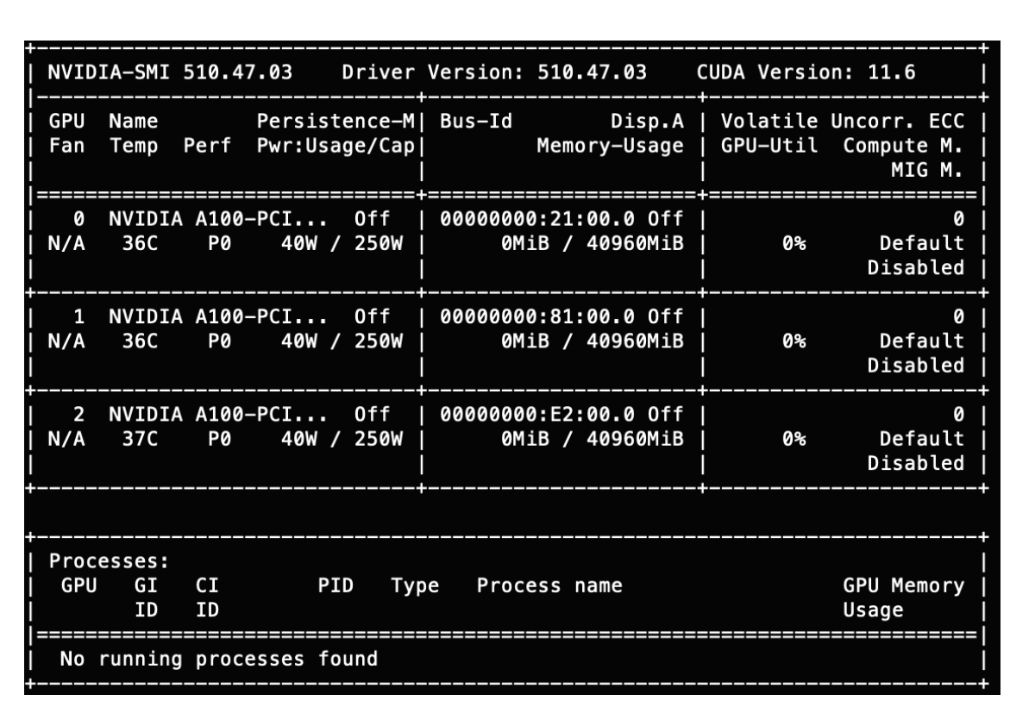
Monitoring GPU Usage
Nvidia-smi
rocm-smi
44

Slide 45
Troubleshooting GPU Workflows
• Is your application and/or code GPU accelerated?
Confirm that you installed the GPU accelerated version!
• Does your application or code support multi-GPU acceleration?
• Is your application ROCM- or CUDA-aware?
You can’t run CUDA code on AMD GPUs. Not all applications are available for AMD GPUs.
• Can your application “see” the GPU?
• Did you request enough CPUs and RAM?
45

Slide 46

Documentation
https://curc.readthedocs.io/en/latest/

Slide 47

Survey and feedback
Survey: http://tinyurl.com/curc-survey18

